Slide 1
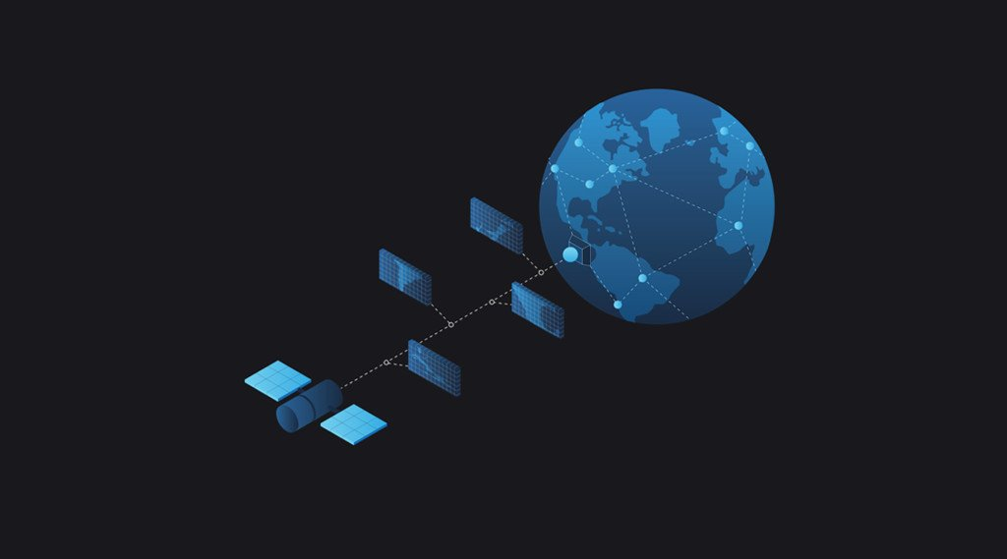
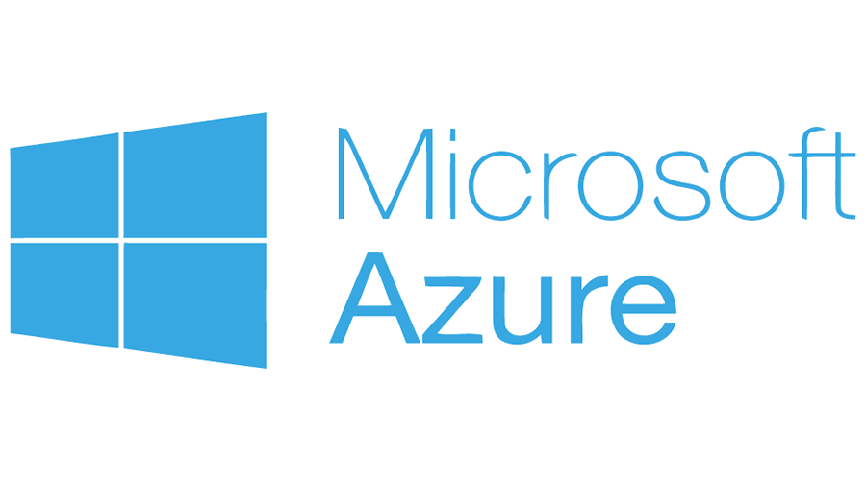
Azure Orbital and its applications
Haocheng Lin

Slide 2
What are we trying to accomplish?
Define the functionalities of Azure Orbital
Learn about the applications of Azure Orbital
Notes:
The learning goals of the presentation help us to define the Azure Orbital functionalities and the areas in which the Orbital can be applied.

Slide 3
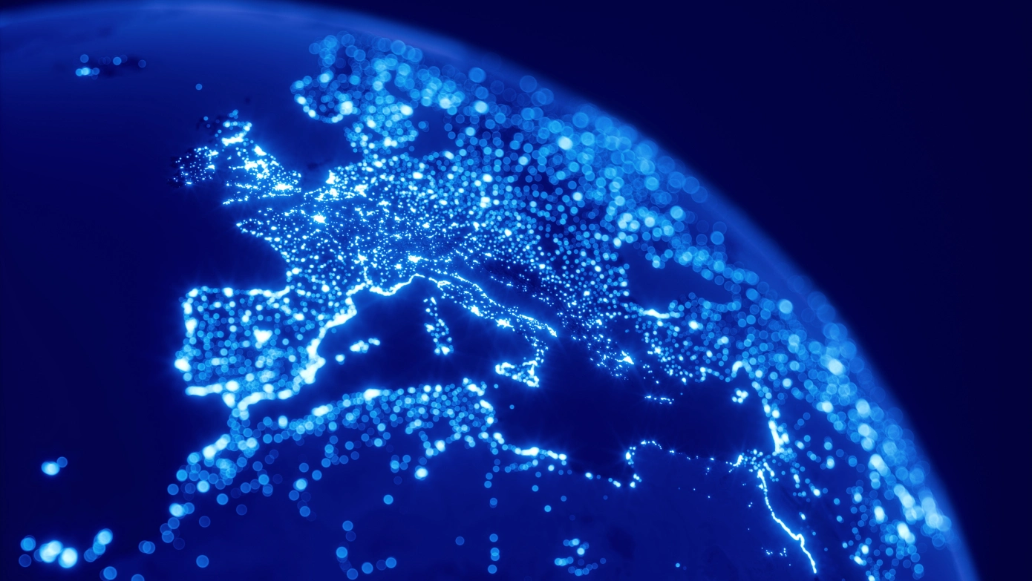
Background
Notes:
Azure Orbital aimed to be an advancement on the existing cloud services by providing a connection with the satellites. The new plan will give the user more flexibility in the plannings, the user can determine the time for machine learning. For space enthusiasts, the new technology can provide more accurate imageries, better connection to ensure a smooth operation, and more available options.

Slide 4
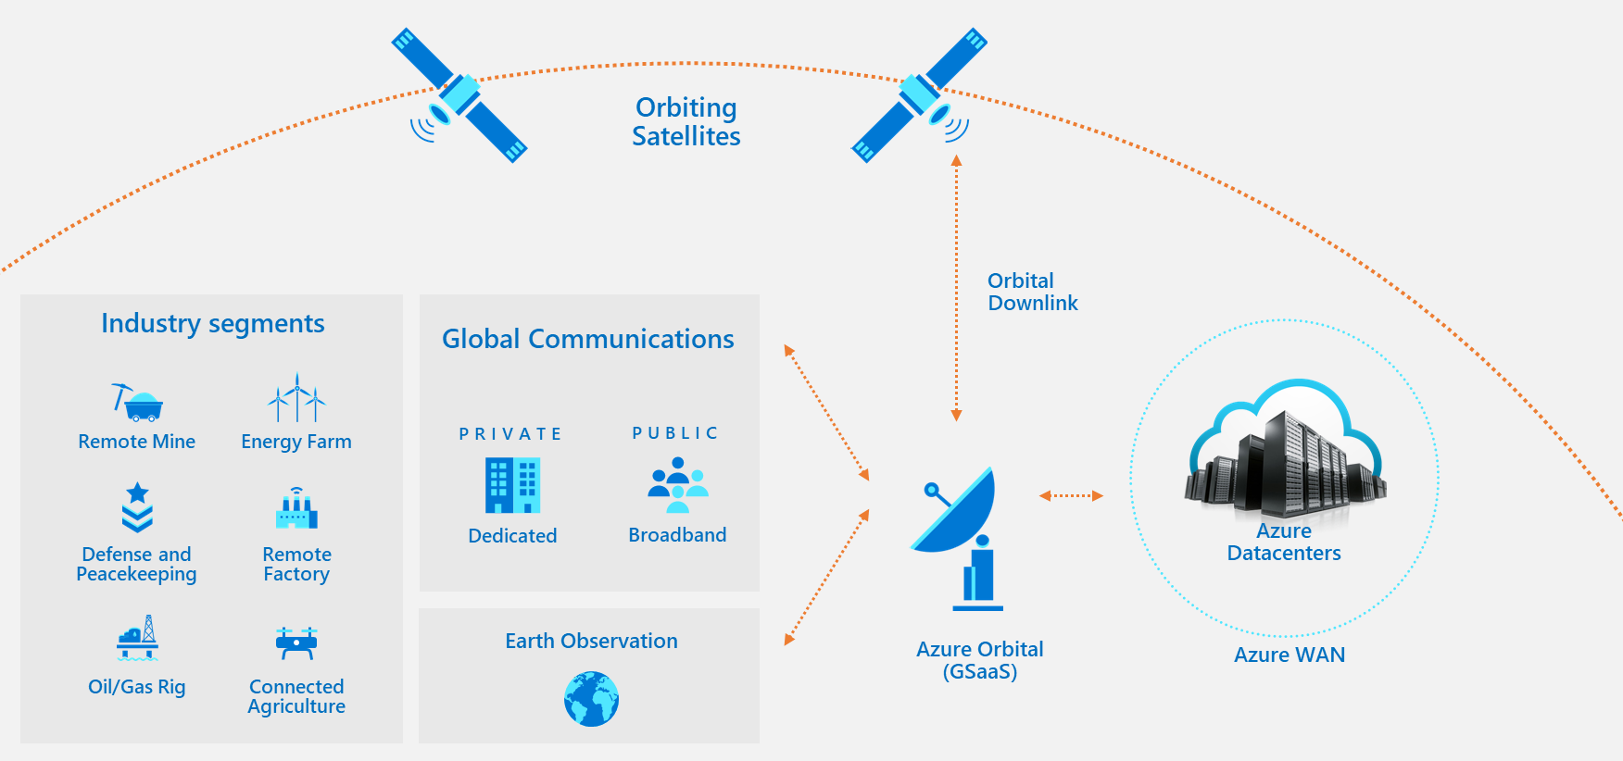
What is Azure Orbital?
Notes:
Azure Orbital is a complex system that enables the transmission of information through intermediate satellites. It has many areas of applications in our lives from national defense to energy production. The system provide a focused approach to the different operations and extends globally, working with the different local systems. There are two main benefits of the Azure Orbital System.

Slide 5



Why do we need to develop Azure Orbital?
Notes:
There are plenty of clouds in the atmosphere. While the clouds are beautiful and provide us with excellent inspirations for photography, they obstruct the satellite observations at times. Azure Orbital has a SpaceEye function to see through the clouds and give us a clearer image of the Earth.

Slide 6

Why do we need to develop Azure Orbital?
Notes:
Microsoft statement showed the extent of challenges posed by the clouds. 67% of the sky is covered by the clouds on average.

Slide 7
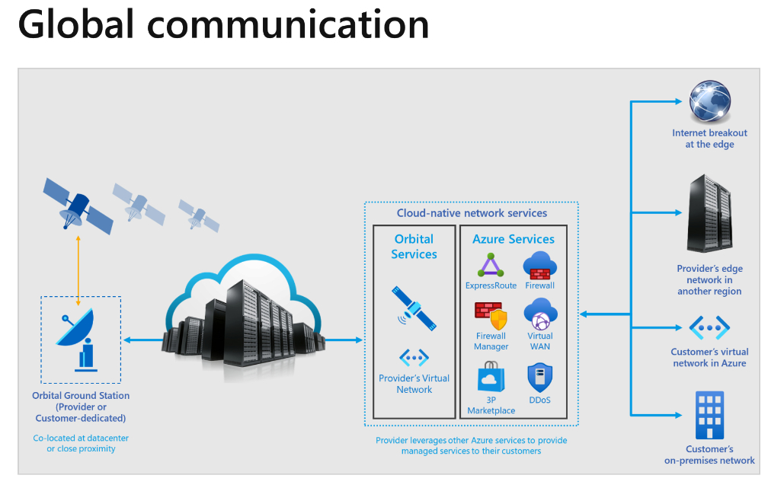
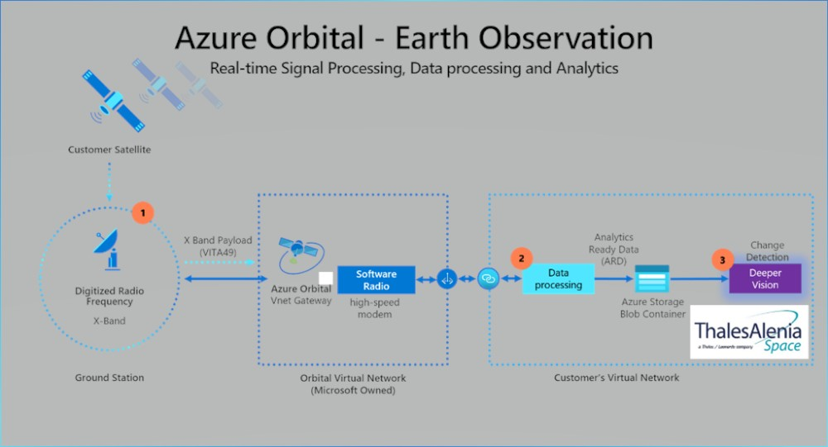
Azure Orbital Applications
Azure Orbital Earth Observation
Azure Orbital Global Communications
Notes:
Azure Orbital can be applied for helping with global communications. This enables the user to obtain data for the machine learning process. DeeperVision software help to analyze the collected Earth data. Its application extend to detecting changes within the geographical landscape and identifying any possible changes in the weather.
Since 2021, Microsoft added the function to process the satellite images. The new upgrade aimed to speed up the download time and to help improving the image analysis. From the upgrade, the users can have a better opportunity for learning about the earth more than before. It brings us a step closer to creating a more sustainable environment.

